Slide 1

BRAINIAC
A game to upgrade your thinking skills

Slide 2
ABOUT ME

Slide 3
Why THIS game?
Technology is making us lazy.

Slide 4



Mini games
1.
Coloricious
2.
Decklicious
3.
Keylicious
-------- Delicious for your mind --------

Slide 5
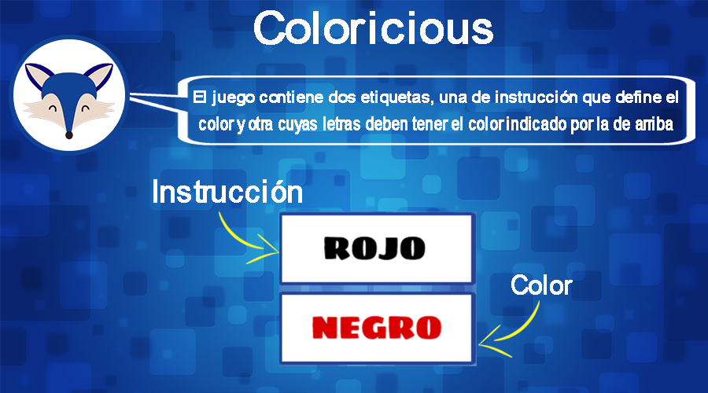
Instructions

Slide 6
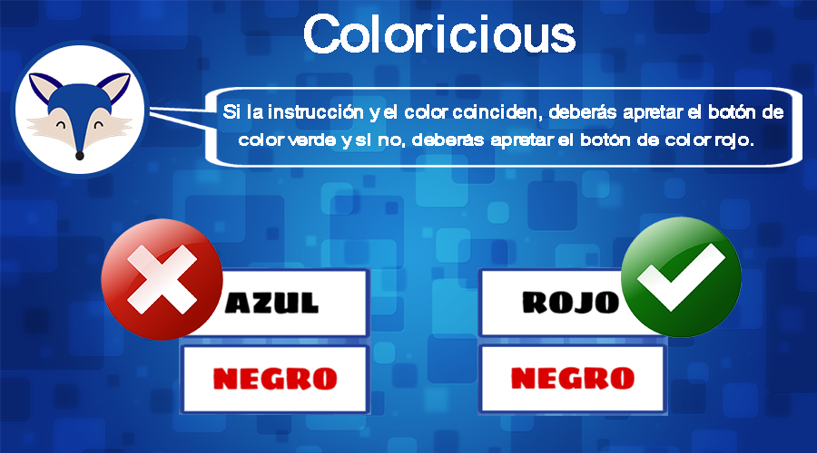
Instructions

Slide 7
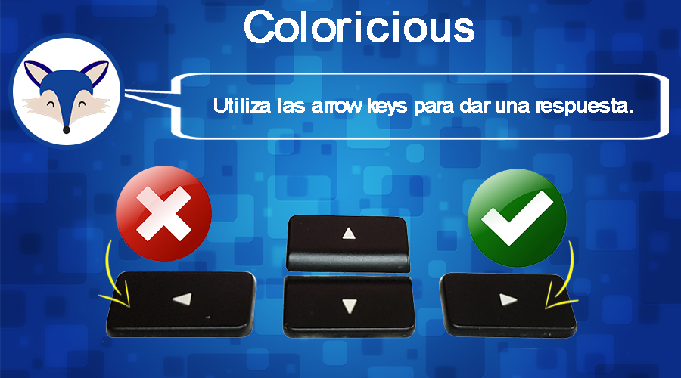
Instructions

Slide 8
DEMO

Slide 9
DEMO

Slide 10
Demo
WE NEED A VOLUNTEER

Slide 11
THANK YOU!

